Slide 1
Topic 7: User Journey Map (part 2)
SECV2113 Human-Computer Interaction
Faculty of Computing
Universiti Teknologi Malaysia

Slide 2
WHAT IS A JOURNEY MAP?
01
DECONSTRUCTION OF A JOURNEY MAP
02
EXAMPLES
03

Slide 3
WHAT IS A
JOURNEY MAP

Slide 4
What is a Journey Map?
A visualisation of the process that a person goes through in order to accomplish a goal
A common UX tool. They come in all shapes, sizes, and formats. Depending on the context, they can be used in a variety of ways
The terms ‘user journey map’ and ‘customer journey map’ can be used interchangeably. Both reference a visualization of a person using your product or service
In its most basic form,
  journey mapping starts by compiling a series of user actions into a timeline
  Next, the timeline is fleshed out with user thoughts and emotions in order to create a narrative
  This narrative is condensed and polished, ultimately leading to a visualisation

Slide 5
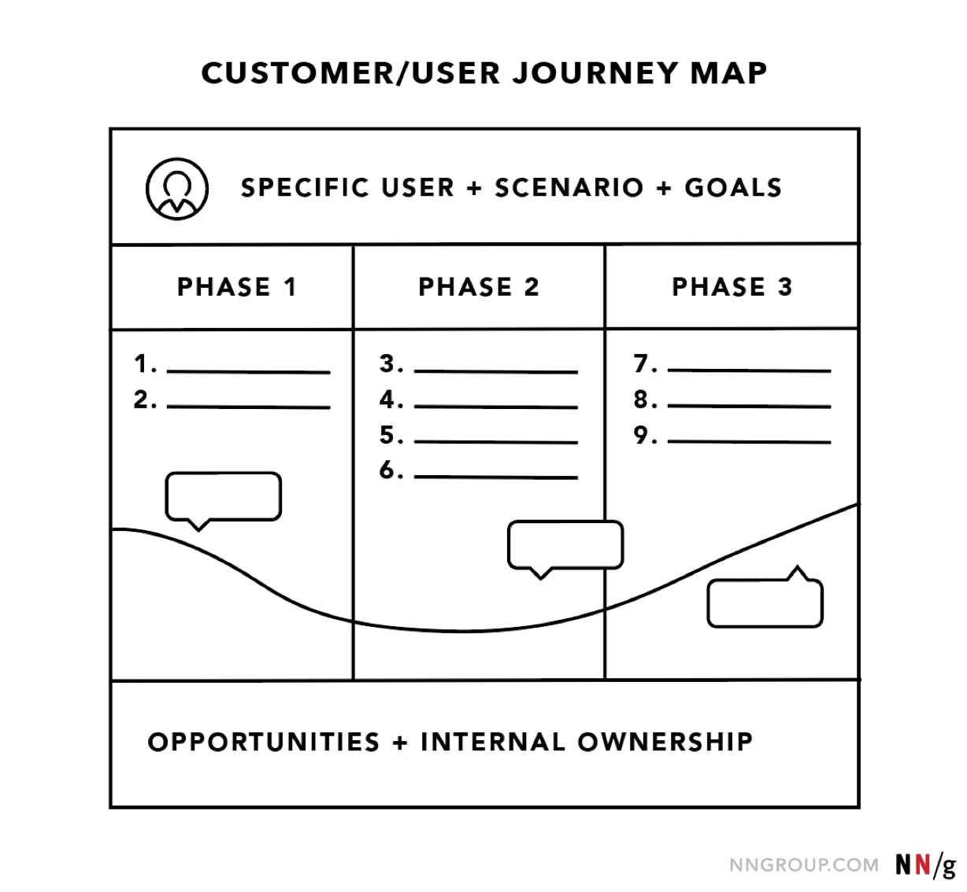

Slide 6
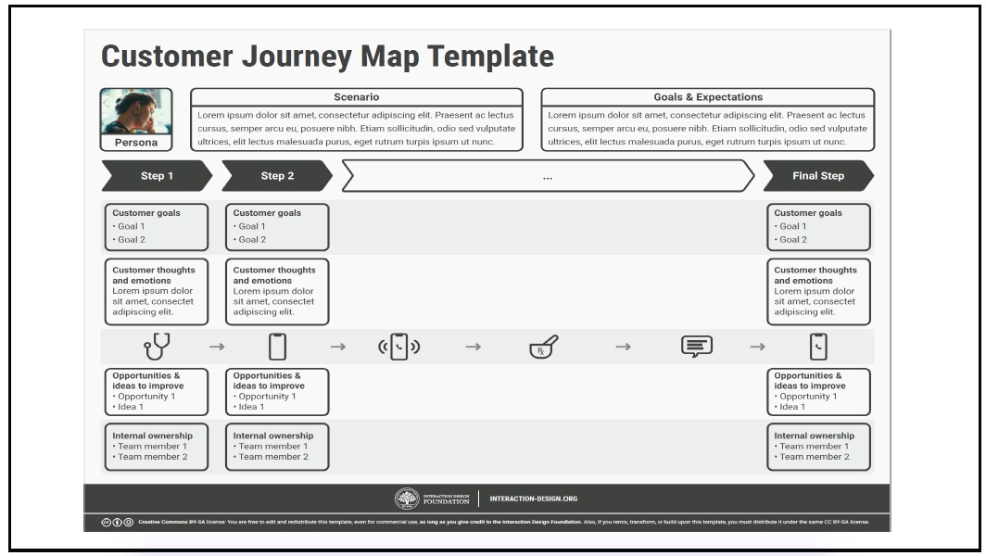

Slide 7
DECONSTRUCTION OF A
JOURNEY MAP

Slide 8
General Model
A journey map tend to follow a general model that includes:
  Zone A: The lens provides constraints for the map by assigning (1) a persona (“who”) and (2) the scenario to be examined (“what”).
  Zone B: The heart of the map is the visualized experience, usually aligned across (3) chunkable phases of the journey. The (4) actions, (5) thoughts, and (6) emotional experience of the user has throughout the journey can be supplemented with quotes or videos from research
  Zone C: The output should vary based on the business goal the map supports, but it could describe the insights and pain points discovered, and the (7) opportunities to focus on going forward, as well as (8) internal ownership.

Slide 9
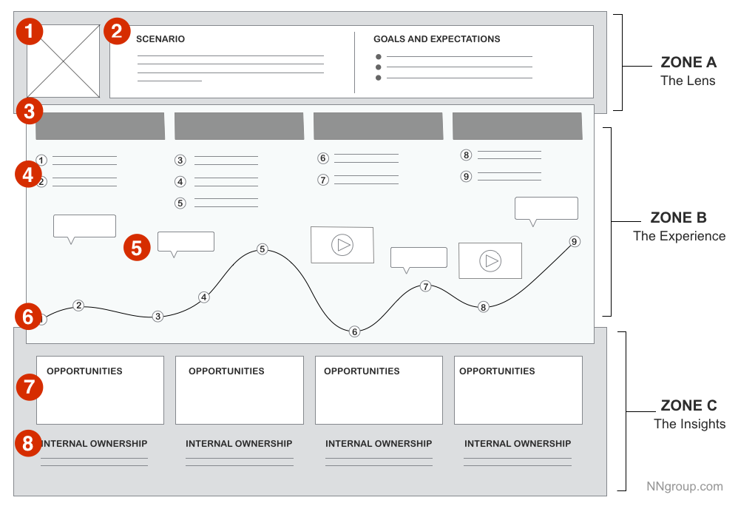

Slide 10
Key Components
The following key elements are common :
  Actor
  Scenario + Expectations
  Journey Phases
  Actions, Mindsets, and Emotions
  Touchpoints and Channels
  Opportunities

Slide 11
Actor
The persona or user who experiences the journey.
Who the journey map is about — a point of view.
Provide one point of view per map in order to build a strong, clear narrative.
  For example, for a student and a faculty member as actor — each would result in different journeys, thus need to build two separate maps

Slide 12
Scenario and Expectations
Describes the situation that the journey map addresses
Associated with an actor’s goal/need and specific expectations.
For example, one scenario could be switching mobile plans to save money, and expectations for it include to easily find all the information needed to make a decision.
Scenarios can be real (for existing products and services) or anticipated — for products that are yet in the design stage.

Slide 13
Journey Phases
The different high-level stages in the journey.
Provide organisation for the rest of the information in the journey map (actions, thoughts, and emotions).
The stages will vary from scenario to scenario; each organization will usually have data to help it determine what these phases are for a given scenario.
Some examples:
  For an ecommerce scenario (like buying Bluetooth speakers), the stages can be discover, try, buy, use, seek support.
  For big (or luxury) purchases (like buying a car), the stages can be engagement, education, research, evaluation, justification.

Slide 14
Actions, Mindsets and Emotions
These are behaviors, thoughts, and feelings the actor has throughout the journey and that are mapped within each of the journey phases
Actions :
  the actual behaviors and steps taken by users
  a narrative of the steps the actor takes during that phase, not meant to be a granular step-by-step log of every discrete interaction
Mindsets :
  correspond to users’ thoughts, questions, motivations, and information needs at different stages in the journey
  Ideally, these are customer verbatims from research
Emotions:
  are plotted as single line across the journey phases, signaling the emotional “ups” and “downs” of the experience
  tells us at which part of the experience the user is feeling delighted versus feeling frustrated

Slide 15
Touchpoints and Channels
Touchpoints - times when the actor in the map actually interacts with the company
Channels - methods of communication or service delivery, such as the website or physical store
Map should align touchpoints and channels with user goals and actions.
These elements are emphasised because they are often where brand inconsistencies and disconnected experiences are uncovered.

Slide 16
Opportunities
Insights gained from mapping; they speak to how the user experience can be optimized.
Insights and opportunities help the team draw knowledge from the map:
  What needs to be done with this knowledge?
  Who owns what change?
  Where are the biggest opportunities?
  How are we going to measure improvements we implement?

Slide 17
EXAMPLES

Slide 18
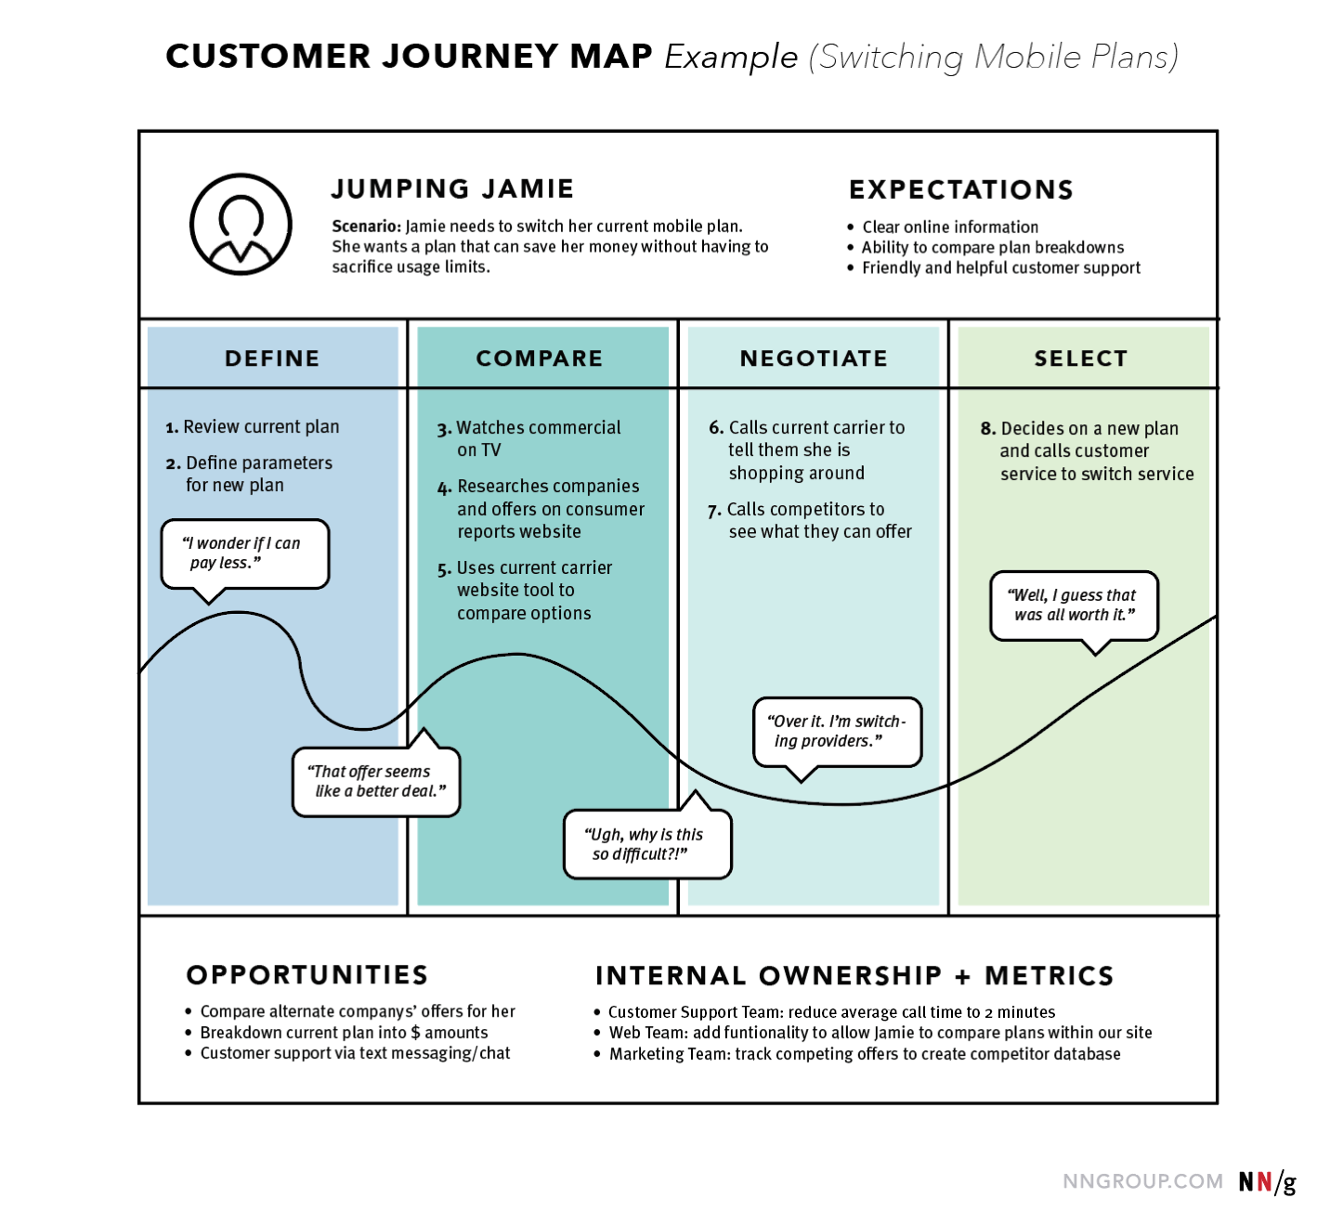
An example of a simplistic, high-level customer-journey map depicting how the persona “Jumping Jamie” switches her mobile plan.

Slide 19
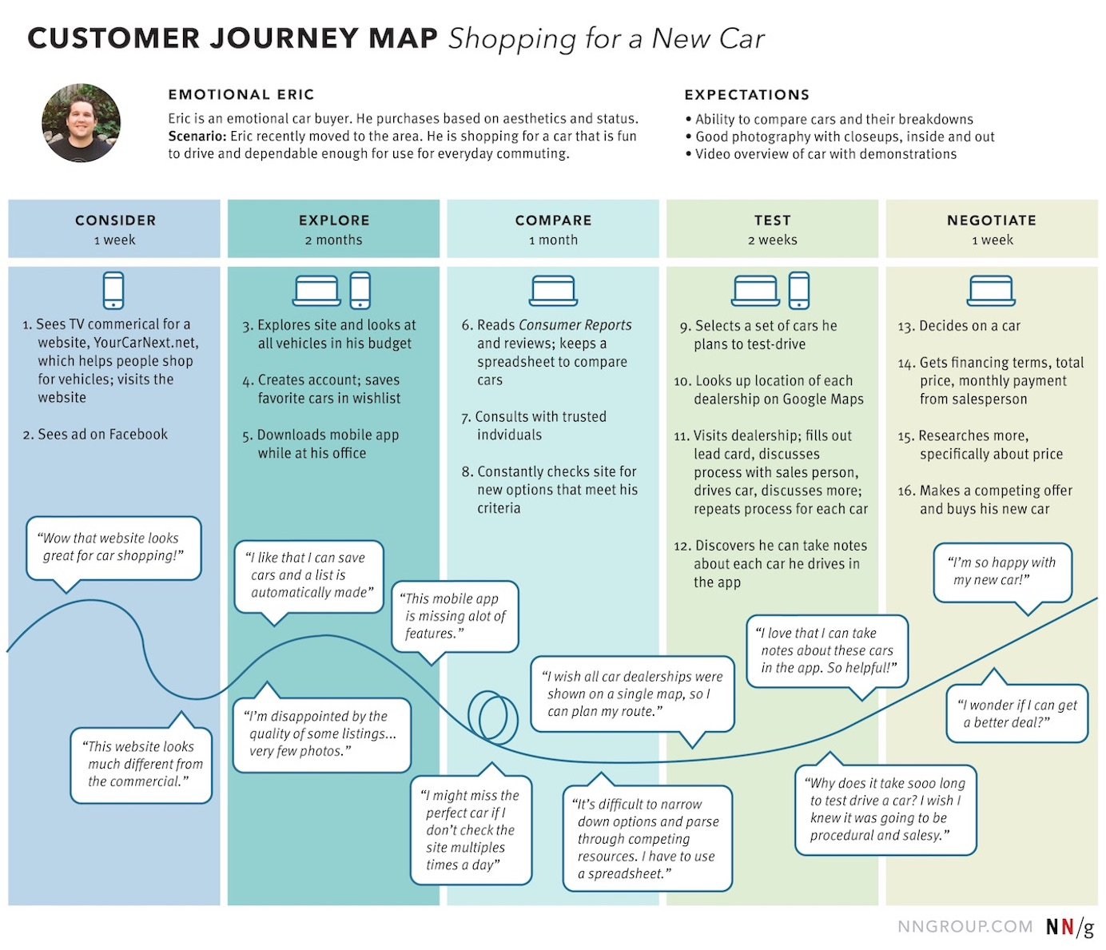
An example of a customer-journey map that communicates the various steps Emotional Eric takes in the process of researching, driving, and purchasing a new car
It provides a high-level narrative of the experience from the user’s perspective.

Slide 20
